Slide 1
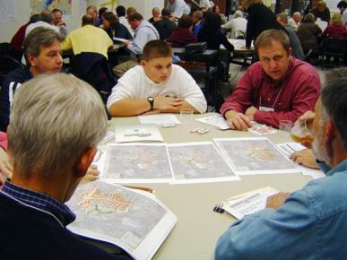
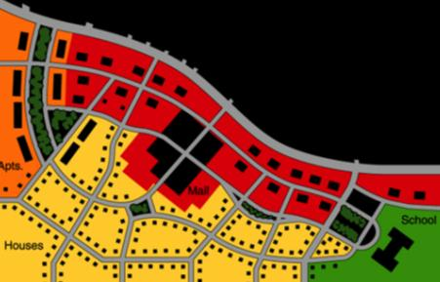
Creating an implementable comprehensive plan
Denny Puko, PA DCED
Jim Pashek, Pashek Associates
2013 National Planning Conference
Session S661

Slide 2
Session outline:
Philosophical approach
Content and organization
Process and participants
Five keys
Research and case study plans
*This session is focused on helping smaller communities

Slide 3
PA DCED funding – 10 years, $24 million grants to local governments for plans and land use ordinances
Too many plans not being implemented, or not even adopted

Slide 4
APA President Mitchell Silver
Planners enamored with “process”
Time to focus on “results”

Slide 5
Think differently about planning
Innovation. Is it…
Doing things better?
Doing better things?

Slide 6
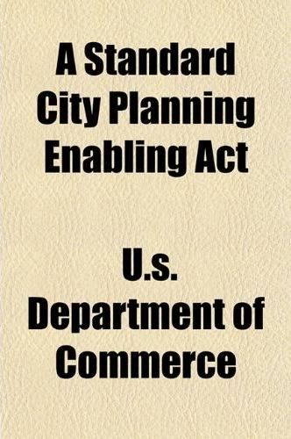
State Enabling Acts
Give communities powers and procedures for planning
Not (typically) a template for a comprehensive plan

Slide 7
Planning is part of a continuum
Problems
Needs
Opportunities
Community is
dissatisfied, restless,
concerned for the future
Problems getting solved
Needs being met
Opportunities pursued
Community is taking action, moving in new directions, making improvements, achieving its vision
Comprehensive Plan

Slide 8
Bottom Line
To create an implementable comprehensive plan, implementation
- not preparation –
of a comprehensive plan
must be the target, the end.
Planners must accept accountability for this!

Slide 9
Tradition – Preparing a comprehensive plan is a worthy goal.
Innovation – Improving your community is a worthy goal. Preparing a comprehensive plan is a means to that goal.

Slide 10
Tradition – A comprehensive plan is a guide to decisions to be made and actions to be taken after the plan is completed.
Innovation – A comprehensive plan is a record memorializing decisions made and actions committed to and initiated during a planning process.

Slide 11
What are ten reasons Comprehensive Plans do not get implemented?

Slide 12
Characteristics of a good plan
Berke & Godschalk – Journal of Planning Literature, 2009 – “Searching for the Good Plan, A Meta-Analysis of Plan Quality Studies”
Vision and assessment of issues.
Goals that reflect public values and vision.
Fact base.
Policies that are sufficiently specific to be tied to definite actions.
Commitments to action with timelines, responsible parties, and financing.
Monitoring and evaluation.
Internal consistency.
Organization and presentation that is understandable for a wide range of readers.
Integration with other public and private plans.
Compliance with enabling legislation.

Slide 13
Ten Questions
Michael Chandler – Planning Commissioner’s Journal, 1995 – “Preparing an Implementable Comprehensive Plan”
Is the plan realistic?
Is the plan comprehensive?
Is the plan specific?
Is the plan linked with related functions?
Does the plan link public and private interests?
Is the plan citizen-focused?
Is the plan understandable?
Is the plan problem- and solution-specific?
Is the plan change-specific?
Is the plan current?

Slide 14
Citizen and stakeholder involvement
Richard Burby – Journal of the American Planning Association, 2003 – “Making Plans that Matter, Citizen Involvement and Government Action”
“…stakeholder advocacy is the critical factor in moving ideas forward from proposals made in plans to actual actions undertaken by governments.”
“With broad participation in plan making, planners develop stronger plans, reduce the potential for latent groups who oppose proposed policies to unexpectedly emerge at the last moment, and increase the potential for achieving some degree of consensus among affected interests.”

Slide 15
Characteristics of PA APA award winning plans
Efficient in words, minimal jargon
Use of accepted publication layout principles
Ideas illustrated by drawings, photos & simulations
Findings related to real issues, with detailed recommendations
Inclusion of ready-to-use samples of tools & practices
Best &
Brightest in
Pennsylvania
Planning

Slide 16
10 yrs. DCED experience
Case study plans
Research
5 keys for an implementable plan

Slide 17
5 keys for an implementable plan
Focus the plan on relevant, real community issues
A plan should be preceded by an assessment of community issues which the plan should address
The work scope should go beyond the “conventional formula”
As the plan is underway, confirm or revise the assessment of issues
Avoid costly generation of information/data not of particular relevance

Slide 18
5 keys for an implementable plan
More on vision, goals, objectives & policies
Do they convey uniqueness?
Or do they look like they could be written for any/every community?
Do they have substance and relevance?
Or are they “mom and apple pie”? Do they state the obvious?
Can they be tied to definite actions?
Or are they so generally written that they can be used to justify almost any or no action?

Slide 19
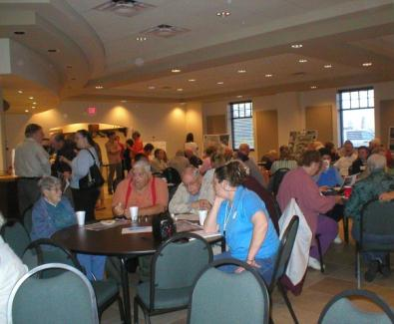
5 keys for an implementable plan
Focus the plan on relevant, real community issues
Heidelberg/Carnegie/Scott Multi-municipal Comprehensive Plan
Pre-assessment SWOT Analysis
LAND USE
Strengths | Weaknesses | Opportunities | Threats
Commercial building inventory Tax incentives/LERTA program Location Business district is level Accessibility excellent between 2 highways | Too many available properties have options, tying up available real-estate Unrealistic market values from property owners Current single-level parking lots take up potential space for new development | Maximize land use with professional guidance Build a parking garage/plan for future parking needs Strengthen/re-write borough codes | Failure to obtain new business will further erode business base Flooding Property asking prices, too high Parking is not adequate to meet potential residents and employees
Notes:
Very successful part of the plan; Good public process makes this an easy key to be able to be successful; Need to be flexible if there is a need for mid-course correction – Crawford County and Shale extraction.

Slide 20
5 keys for an implementable plan
Focus the plan on relevant, real community issues
Tradition
Historic & Natural Resources
Recreation
Transportation
Land Use
Housing
Community Facilities
Economic Development
Innovation
Chartiers Creek
Increasing population via improved Housing
Route 50 Revitalization
Carothers Avenue Redevelopment
Downtown Carnegie Improvements building on other recent studies
Walkability

Slide 21
5 keys for an implementable plan
2. Organize the plan the way local officials and citizens think
Organize the plan around issues instead of functional chapters
Meetings should also be organized around the issues, and should be work sessions for finding solutions
Be efficient in words, avoid jargon and use accepted publication layout practices

Slide 22
5 keys for an implementable plan
2. Organize the plan the way local officials and citizens think
Chartiers Creek
Flooding
Recreation
Chartiers Creek
Increasing population via improved Housing
Route 50 Revitalization
Carothers Avenue Redevelopment
Downtown Carnegie Improvements building on other recent studies
Walkability
Notes:
Organizing focus groups with “experts” can make achieving this key successful; important to have elected officials involved; need to use a straight-forward, linear, rational approach so that any person can understand how we arrived at the recommendations, no “leap of faith”; This is an important Issue, the Issue is Valid, this is how we hope the Issue will play out in the future, this is specifically how we will get there; For Walkability chapter, we toured community with Council person in wheel chair.

Slide 23
5 keys for an implementable plan
2. Organize the plan the way local officials and citizens think
Chartiers Creek – Flooding
A. Introduction to the Issue
B. Validation of the Issue
C. Vision for Future
D. Implementation Strategies

Slide 24
5 keys for an implementable plan
2. Organize the plan the way local officials and citizens think
Chartiers Creek – Flooding Implementation Steps
Tier 2:
- Develop a quick response plan
Tier 1:
- Creating and distributing an informational flier regarding flooding in the communities; and
- Developing an immediate alert system to warn residents of coming floods.
Tier 3:
- Update floodplain management regulations

Slide 25
5 keys for an implementable plan
3. Devise practical and workable recommendations
Priority recommendations should include depth and detail – specific action plans
Priorities should consider workability of recommendations
Plans should provide a small number of recommendations with practical depth and detail instead of a large number of general recommendations
Plans should use “non-traditional” but practical tools – market analysis, photo simulations, concept drawings, pro forma analysis

Slide 26
5 keys for an implementable plan
3. Devise practical and workable recommendations
Project Prioritization Worksheet
Optimizing Financial Viability of the two Boroughs | Most Important (I) | Easiest to Accomplish (E)
Combine water authorities | 1 | 0
Form a joint recreation commission and merge the boroughs' land assets | 2 | 0
Share Public Works equipment and jointly purchase new equipment | 5 | 1
Coordinate leaf collection | 2 | 5
Coordinate snow removal | 1 | 4
Share night-time on-call services | 0 | 2
Utilize borough property at reservoirs or airport to compost leaves into topsoil | 0 | 2
Coordinate joint purchasing of administrative supplies and cell phone agreements | 3 | 4
Jointly bid for health/disability/workman's comp benefits for employees | 4 | 3
Consolidate IT services | 4 | 4
Jointly contract legal counsel and engineering consulting services | 1 | 2
Jointly bid for garbage services | 2 | 1
Develop an annual rental inspection ordinance | 1 | 0
Notes:
Tempting to suggest lots of strategies like “work toward improving the downtown” or apply for a grant to do another study. However, we must match the number of strategies with the capacity to achieve success with those strategies. This is not dumbing down the report but shifting focus from lots of strategies with little detail to fewer strategies with more detail. In theory, should take the same amount of consulting time to do either methodology. Half of strategies we generate from analysis, research and interviews. Other half from community. We rank all of the ideas, then focus on the most important and achievable strategies. Note “come to Jesus” meeting with 3 borough managers on top ten action steps – testing capacity before final recommendations are set. Tier I or high priority strategies must have some detail to allow municipality to move forward without consultant help. Note Shared Services Ordinance in ZH plan. We specified which PW equipment might be shared and how that would work.

Slide 27
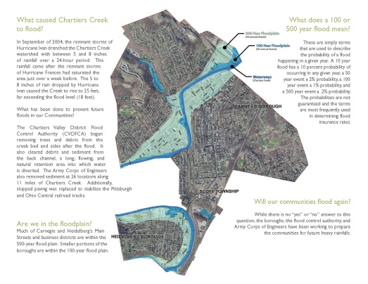
5 keys for an implementable plan
3. Devise practical and workable recommendations

Slide 28
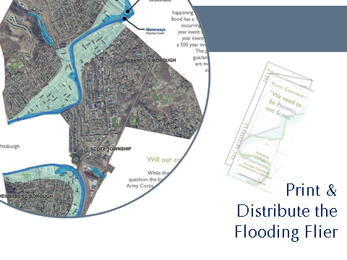
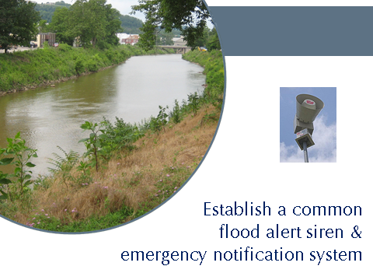
5 keys for an implementable plan
3. Devise practical and workable recommendations

Slide 29
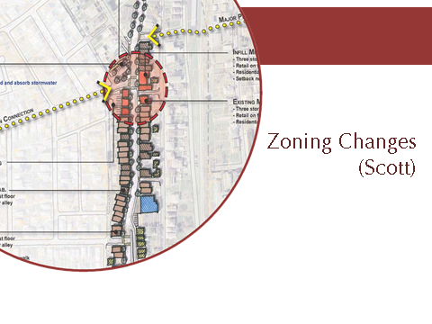
5 keys for an implementable plan
3. Devise practical and workable recommendations

Slide 30
5 keys for an implementable plan
3. Devise practical and workable recommendations

Slide 31
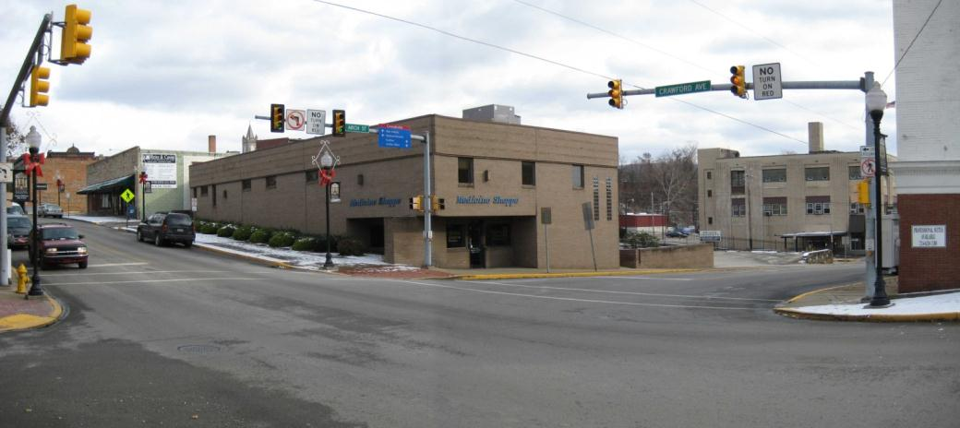
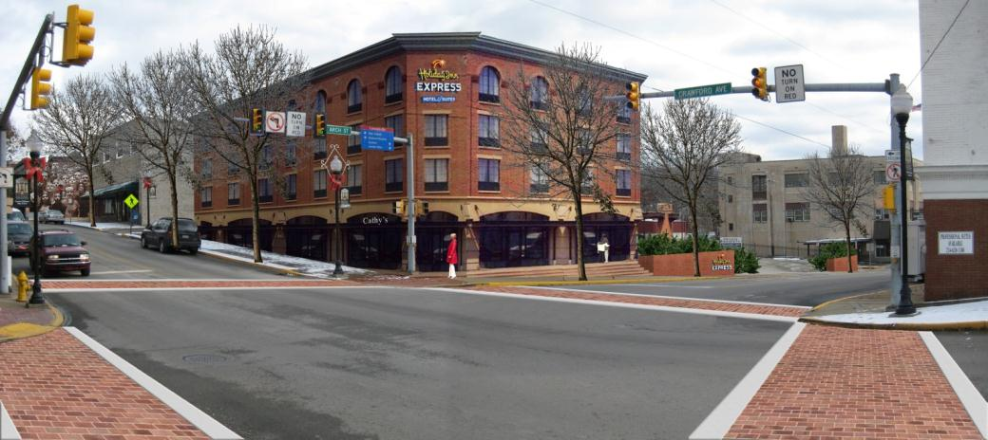
5 keys for an implementable plan
3. Devise practical and workable recommendations
Visual communications that everyone understands

Slide 32
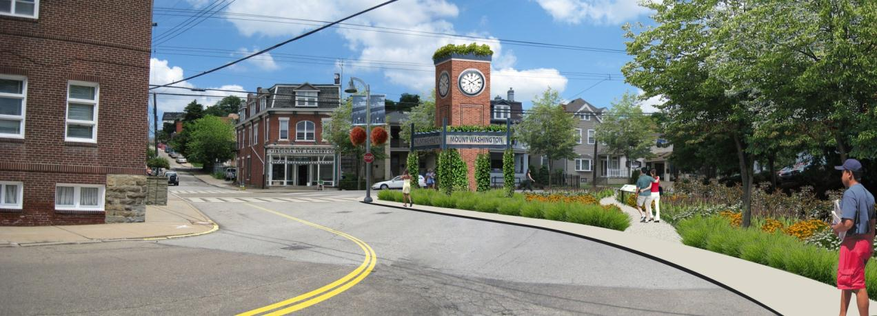
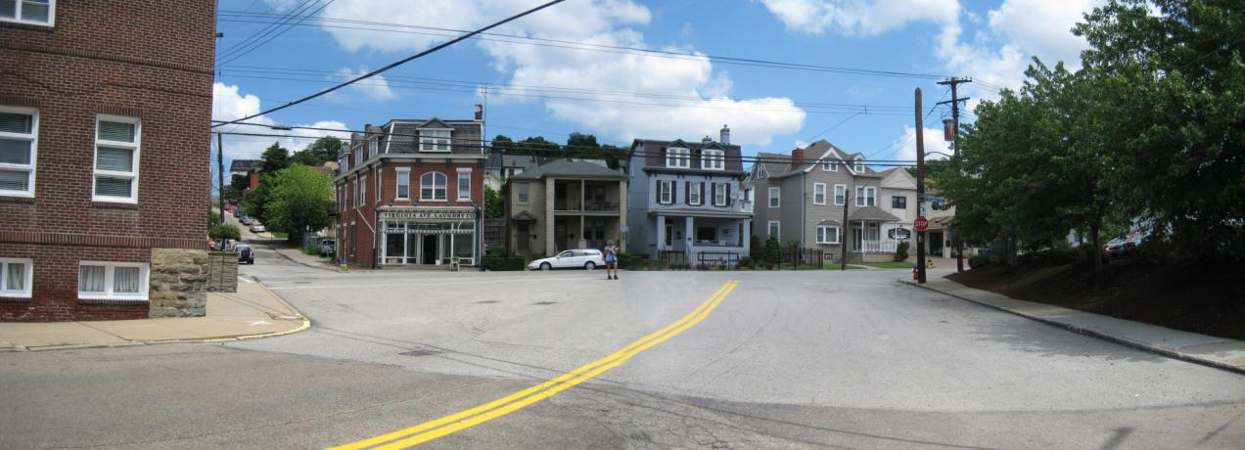
5 keys for an implementable plan
3. Devise practical and workable recommendations
Visual communications that everyone understands

Slide 33
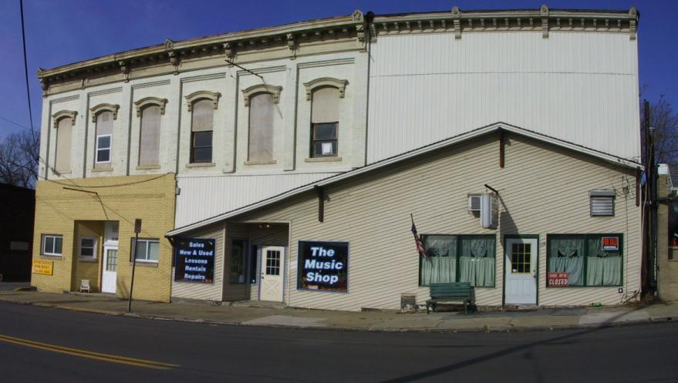
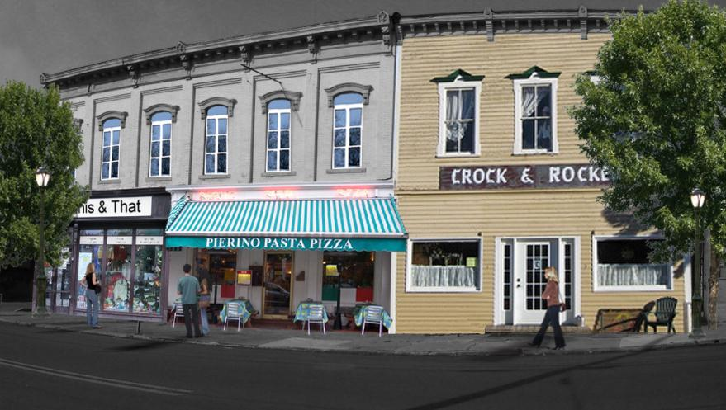
5 keys for an implementable plan
3. Devise practical and workable recommendations
Visual communications that everyone understands

Slide 34
5 keys for an implementable plan
4. Recruit partners and create capacity to implement the plan
Recruit organizations and individuals with expertise and capacity; involve them in planning; ask them to take responsibility
Start implementation before plan done
Establish a coordinator responsible for implementation
Planning process is not done until capacity to implement is in place

Slide 35
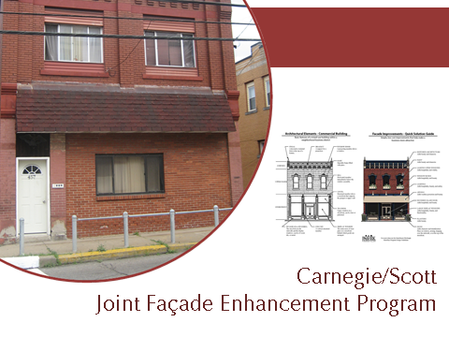
5 keys for an implementable plan
4. Recruit partners and create capacity to implement the plan
Year One Implementation Schedule | 2010 |  |  |  |  |  |  | 2011
 | June | July | August | September | October | November | December | January | February | March | April | May | June
Overarching Strategies
Hold quarterly joint Borough Council Meetings | • |  |  | • |  |  | • |  |  | • |  |  | •
Part 1: Controlling Borough Costs while Maintaining or Enhancing Services
Borough Councils appoint a Shared Services Committee to drive the implementation of the projects in Part 1
Shared Services Committee develops recommendations to present to the Borough Councils at the quarterly joint Borough Council Meeting. |  |  |  | • |  |  |  |  |  | •
Borough Council act upon Shared Services Committee’s recommendations.
Notes:
Weakest part of our planning experience. In focus groups, connections were made with other authorities, county or state staff who might be able to help with implementation. The project was put on their radar. For redevelopment of H. we had a workshop w/ elected officials on next steps in their development plan.

Slide 36
5 keys for an implementable plan
5. Get local ownership of the plan - commitment to implement it
Plan should reflect political buy in to sustain implementation over time
Elected officials should learn about recommendations during the planning process, not at the end
Steering committee and elected officials should be able to readily talk about 3-5 priority recommendations

Slide 37
5 keys for an implementable plan
5. Get local ownership of the plan - commitment to implement it (continued)
There should be community presence at the final public meeting and they should be supportive
Plan process promotes a commitment to action after adoption
After adoption, should be on elected officials’ agenda – conscious effort to track progress on implementation

Slide 38
5 keys for an implementable plan
5. Get local ownership of the plan - commitment to implement it
Notes:
Believe this process has a greater chance to have ownership and commitment to implement the plan when you have worked on issues that are important to the communities. However, a very good motivated manager could implement a poor plan and those that are not committed, might not get very far with a focused, issues oriented plan. Topics from the community often come with cheerleaders already in place. We have seen mixed results. There still seems to not be any accountability for follow through. Councils are not asking staff which implementation strategies they are working on in any given month and each year, what objectives have they achieved. Tried to structure this with ZH. Suggest using an ICA for Implementation for 1-2 specific strategies covering more than one municipality – may result in more accountability. Mention ZH celebration at the end of the project – steering committee members gave a majority of the presentation.

Slide 39
5 keys for an implementable plan
5. Get local ownership of the plan - commitment to implement it
10 things Zelienople and Harmony have done since the plan was completed
Enacted draft Shared Services Ordinance prepared as part of the plan.
Share snow removal and leaf collecting routes that are logical and not stop at political boundaries.
Hope to begin doing more shared administrative services.
Based on Main Street focus in the plan, obtained $25,000 from Council to seed funding from banks and other organizations to hire a consultant to prepare a more detailed design study of the business districts.
Obtained a DCED grant to purchase new street signs that share a common appearance.
Notes:
Believe this process has a greater chance to have ownership and commitment to implement the plan when you have worked on issues that are important to the communities. However, a very good motivated manager could implement a poor plan and those that are not committed, might not get very far with a focused, issues oriented plan. Topics from the community often come with cheerleaders already in place. We have seen mixed results. There still seems to not be any accountability for follow through. Councils are not asking staff which implementation strategies they are working on in any given month and each year, what objectives have they achieved. Tried to structure this with ZH. Suggest using an ICA for Implementation for 1-2 specific strategies covering more than one municipality – may result in more accountability. Mention ZH celebration at the end of the project – steering committee members gave a majority of the presentation.

Slide 40
5 keys for an implementable plan
5. Get local ownership of the plan - commitment to implement it
10 things Zelienople and Harmony have done since the plan was completed
The joint shared services committee meets on a regular basis to track progress on implementing the recommendations of the plan.
Obtained funds from SPC to retime traffic signals on Main Street to improve traffic flow.
Funded an update to their community pool and leveraged a private donation to build an amphitheater in their park.
Shared salt purchases.
Council people from both municipalities meet regularly on Saturdays for breakfast to talk about common issues.
Notes:
Believe this process has a greater chance to have ownership and commitment to implement the plan when you have worked on issues that are important to the communities. However, a very good motivated manager could implement a poor plan and those that are not committed, might not get very far with a focused, issues oriented plan. Topics from the community often come with cheerleaders already in place. We have seen mixed results. There still seems to not be any accountability for follow through. Councils are not asking staff which implementation strategies they are working on in any given month and each year, what objectives have they achieved. Tried to structure this with ZH. Suggest using an ICA for Implementation for 1-2 specific strategies covering more than one municipality – may result in more accountability. Mention ZH celebration at the end of the project – steering committee members gave a majority of the presentation.

Slide 41
5 keys for an implementable plan
Lessons Learned
Fluid Process, need to be flexible
Tension between the Scope of Work and a Plan that creates its focus
Staff being uncomfortable with unknowns; lost without a template
Need buy-in on the Process
Consider a new way of creating a Comprehensive Plan
Managing Expectations – how much is enough detail for a Tier I strategy?
“It is good to have an end to journey towards; but it is the journey that matters in the end”
Notes:
1. Staff need to be able to let go of a topic that they may have invested time in but ends up as a lower priority. 2. How do you submit a proposal including costs for subconsultants when you do not know if you will need a transportation engineer or not? How does an Owner know that they are getting what they contracted for? Pre-planning with a SWOT analysis and prioritization workshop could solve this. 3. Staff is comfortable cranking out 30-40 pages of demographic analysis that may or may not inform the final recommendations. 4. We have had elected officials say they agree with this process until the very final presentation when they question why we did not address topic A or B, issues that were deemed by everyone as not important. 5. 3 mo in pre-planning, 12 months in planning, 12 month for capacity building, signing of an ICA for implementation and implementing several strategies with $10,000 of funds for each community followed by 3 mo of assessment – scorecard which might be the accountability that seems to be missing.

Slide 42
4 things we hope you will take home with you from this session:
Planners should think differently about a comprehensive plan
The content and organization of a plan matters, and should not follow the old “template”
A plan should not be considered complete until capacity to implement it is in place
A plan should become part of the daily conversations by elected officials and staff

Slide 43
Questions???

Slide 44
Links
Heidelberg-Carnegie-Scott Multi-municipal Comprehensive Plan
http://heidelbergpa.tripod.com/sitebuildercontent/sitebuilderfiles/compplan.pdf
Zelienople-Harmony Joint Comprehensive Plan
http://zelieboro.org/Zelienople-Harmony-Joint%20Comprehensive%20Plan.pdf
Lititz-Warwick Joint Strategic Comprehensive Plan
www.warwicktownship.org
Mechanicsburg Borough Comprehensive Plan
www.mechanicsburgborough.org/codes.html

